Slide 1

Developing tomorrow’s leaders
Karen Schmidt
@letsgrowptyltd
Notes:
Website for resources . . .

Slide 2

Is your organisation going to be ready?
Notes:
CIPD Chartered Institute of Personnel and Development UK “Shaping the future” report

Slide 3
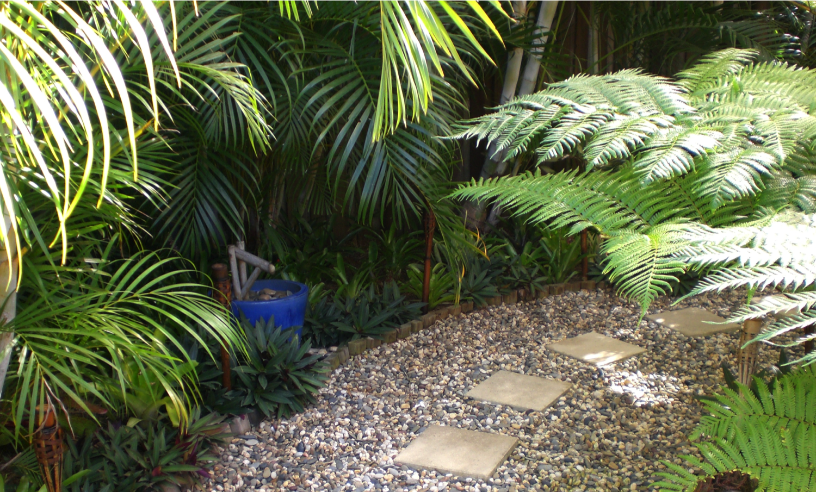
A great leader is like a great gardener

Slide 4
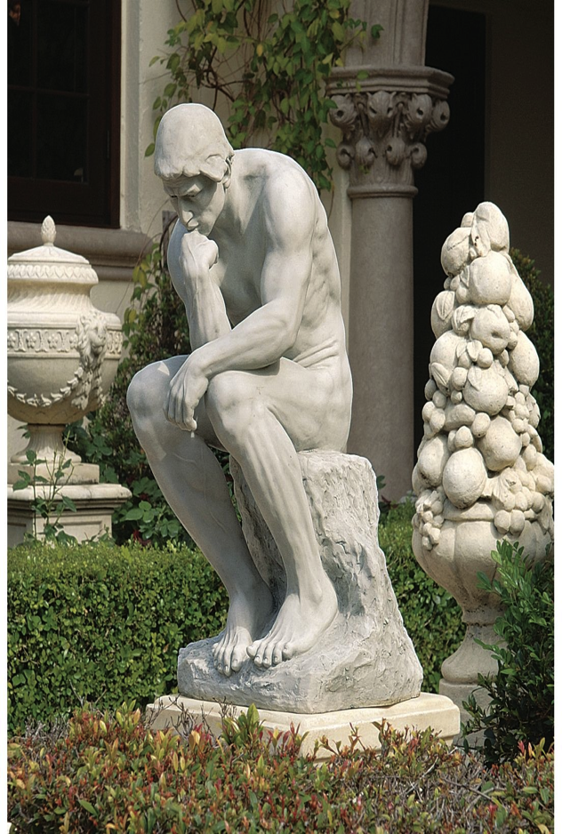
Workplace gardening philosophy
Great teams are organic
Work with the nature of people
People grow at their own pace
Create an environment where people can thrive
Knowledge + skills + attitude = Green Thumb Leader

Slide 5
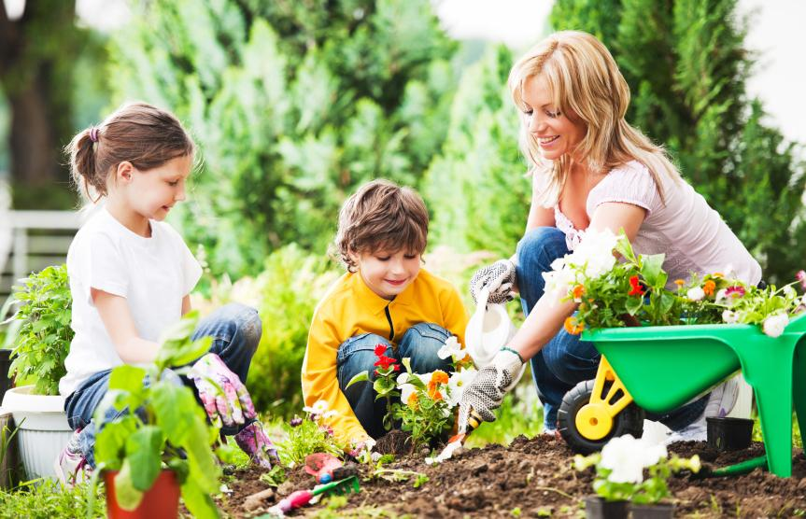
Nurturing a love of leading

Slide 6

Tonight I want to look at . . .
Being clear on why you want to lead
5 skills you need to develop
3 ways to fast track your career

Slide 7

Why do you want to lead?

Slide 8
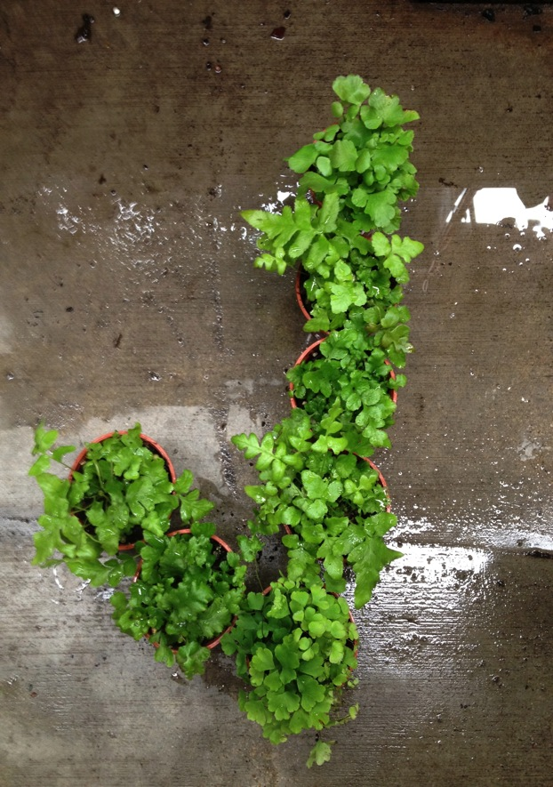
Right reasons to lead
Passion for making a difference
Powerful vision
Use your strengths
To give back

Slide 9
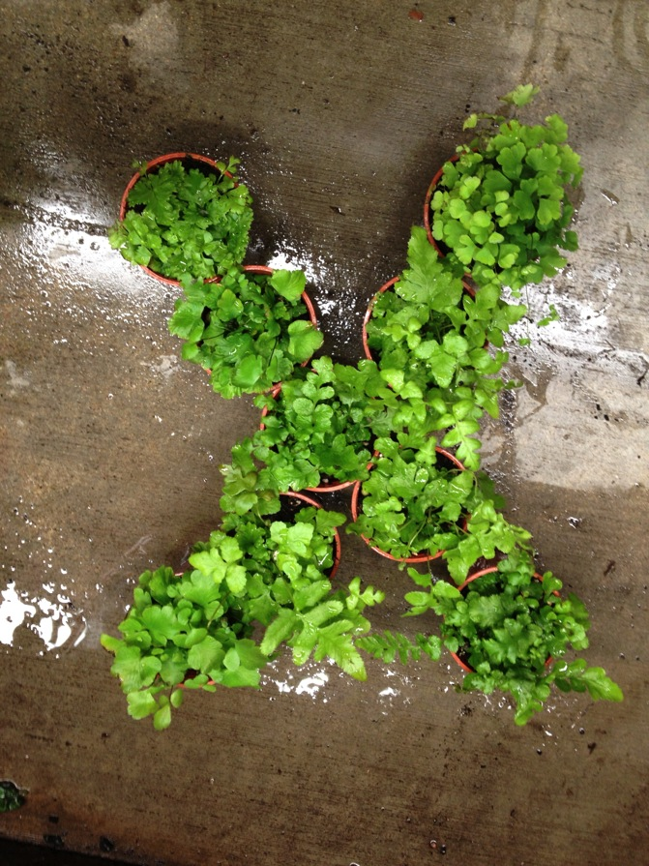
Wrong reasons to lead
Status
Power
Revenge
Ego

Slide 10
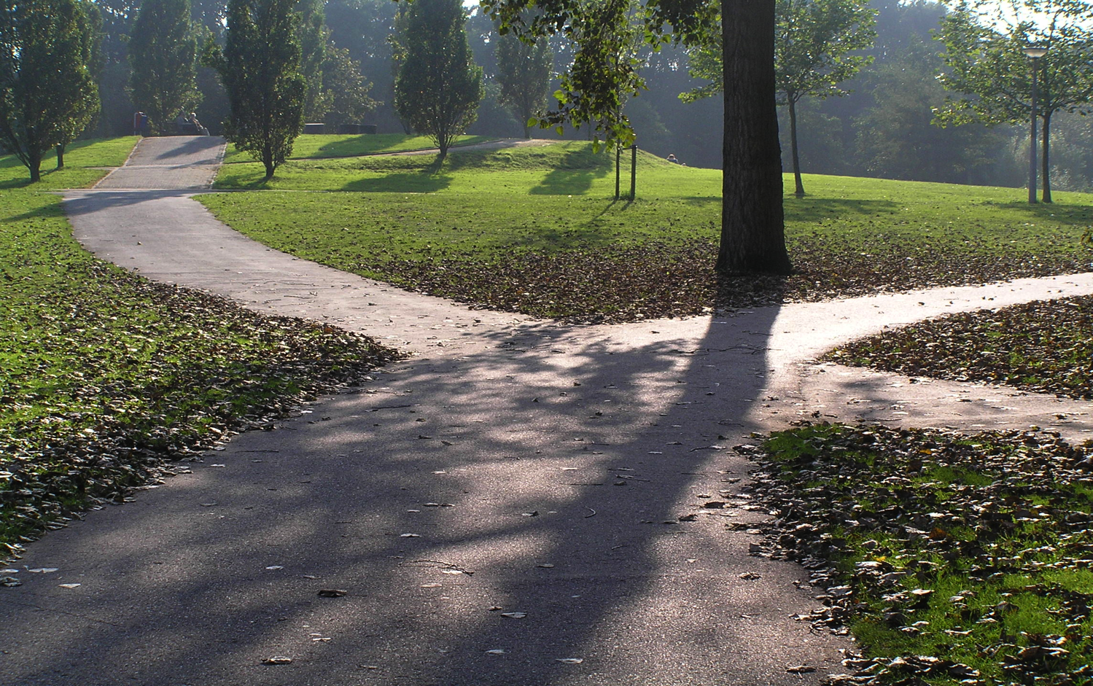
Many different paths for leaders

Slide 11

5 keys to success on any path
Role
Mindset
Style
Communication
Growth

Slide 12
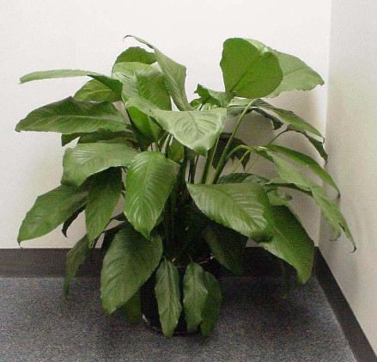
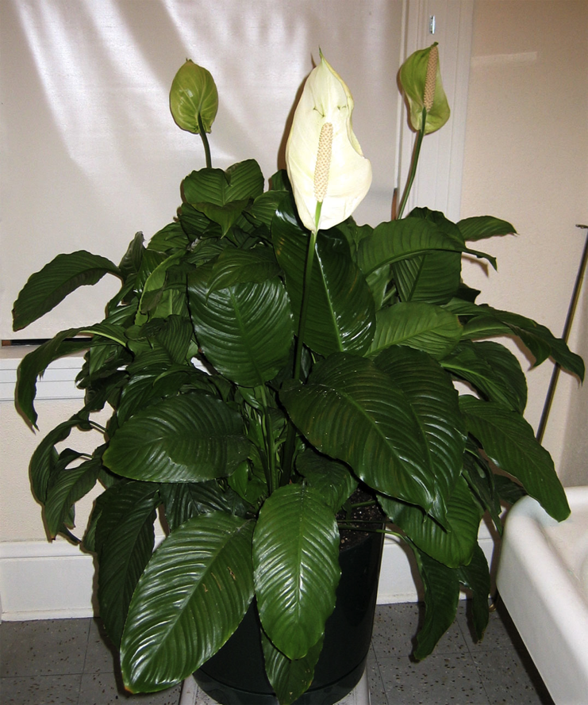
Manager
v
Leader

Slide 13
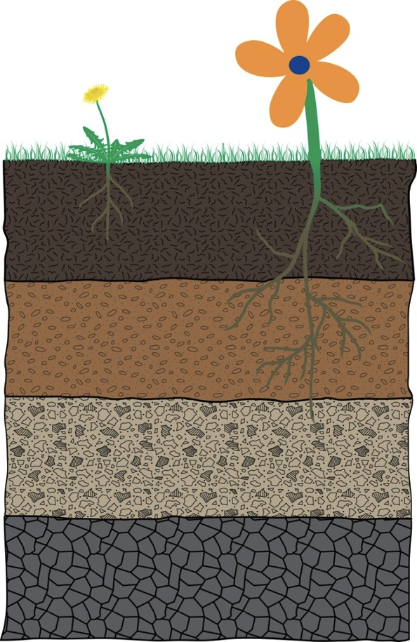
Creating a healthy culture
Organic layer
See
Top soil
Do
Sub soil
Say
Parent material
Think
Bedrock
Feel
Notes:
Organic layer See What outsiders observe. The visible results. Are they productive plants or annoying weeds?
Top soil Do How people act towards each other and respond to situations. The practices that get rewarded, the way they implement the things they say
Sub soil Say What staff, clients and suppliers say about the organisation, how your written policies and procedures express the way you think and feel. This is where the base roots are usually found
Parent material Think the mindset you want your people to have, particularly the leaders, based on the feel/values
Bedrock Feel The values you live by that support everything you do

Slide 14
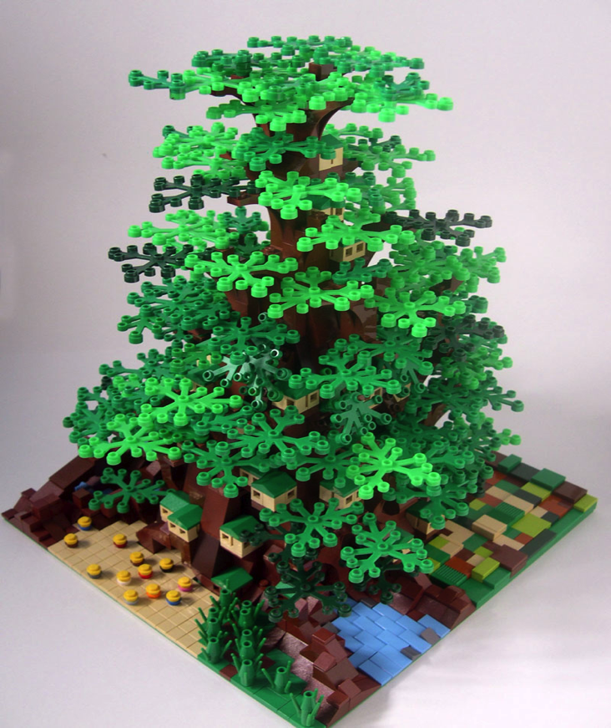
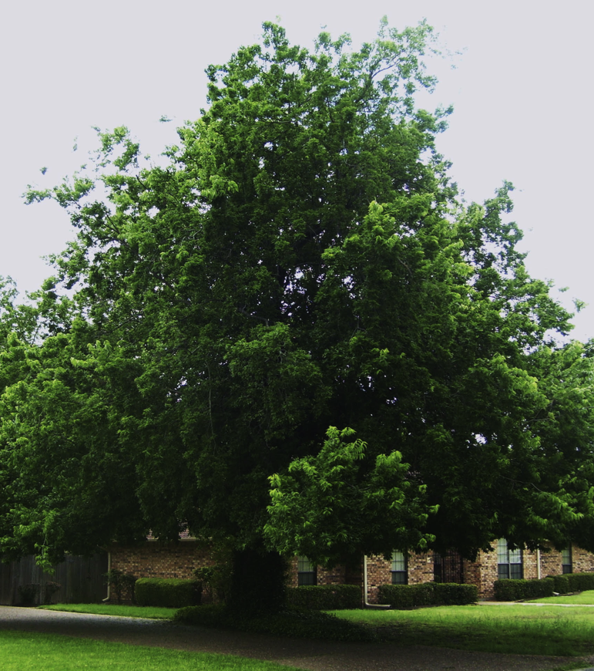
Team builder
Team grower

Slide 15

Defining engagement
Hands
Heart
Head

Slide 16
The engagement matrix
 Skills 
Green
Keen
Potential performer
High performer
 Attitude 
Has Been
Mean
Non performer
Under performer

Slide 17
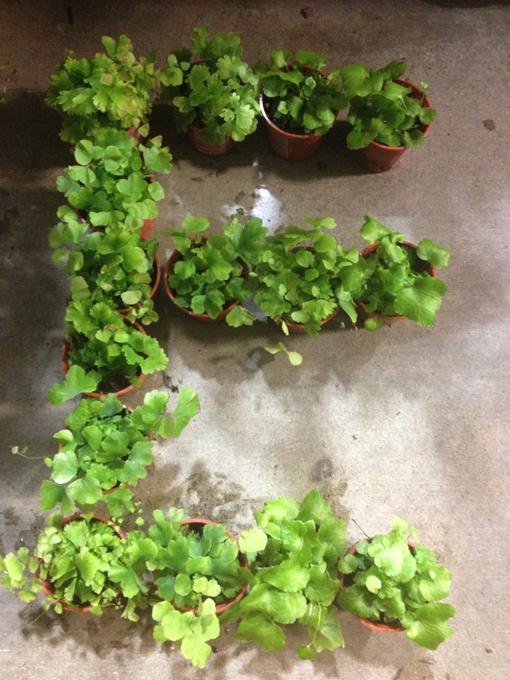
Signs of an engaging leader
Energetic
Enquiring
Enlightened
Egalitarian
Enabler
Endurance
Explorer
Educator
Egoless
Eloquent

Slide 18
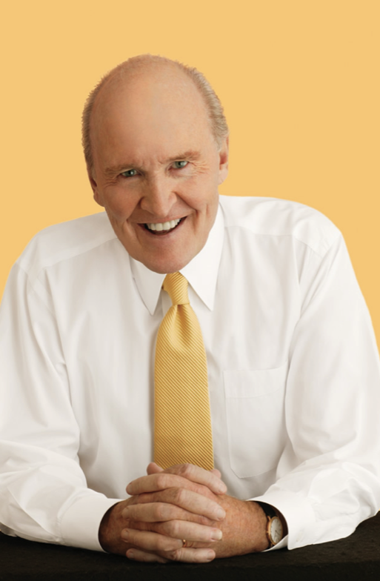
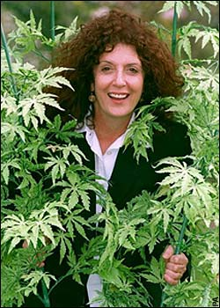
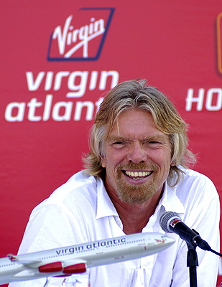
Which style do you relate to?
Jack Welch
Anita Roddick
Richard Branson

Slide 19
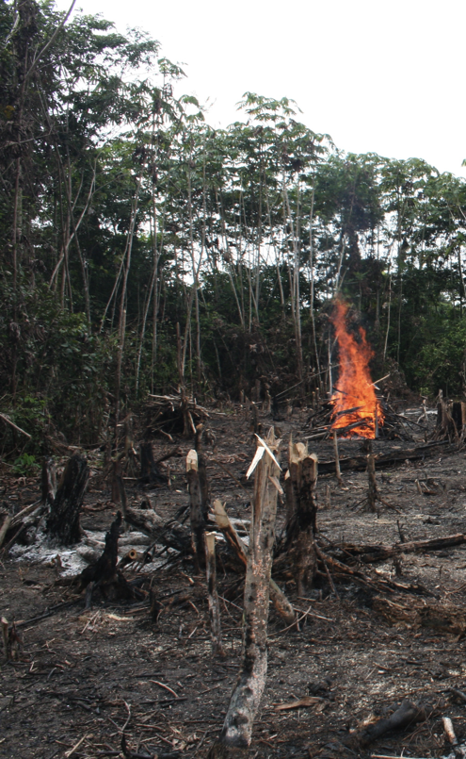
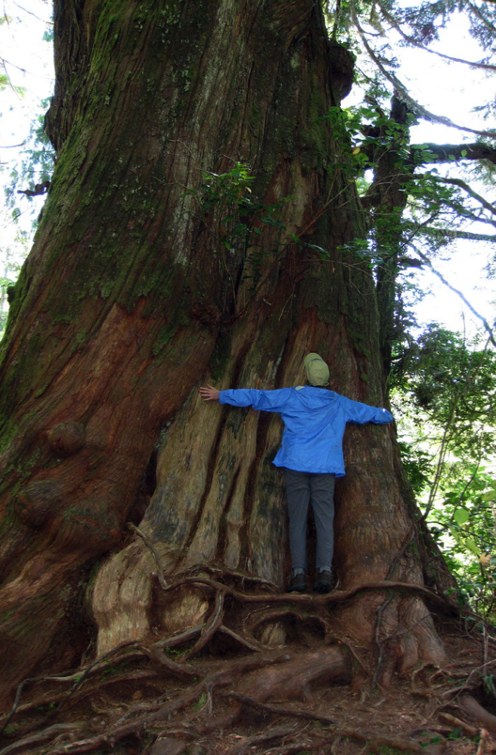
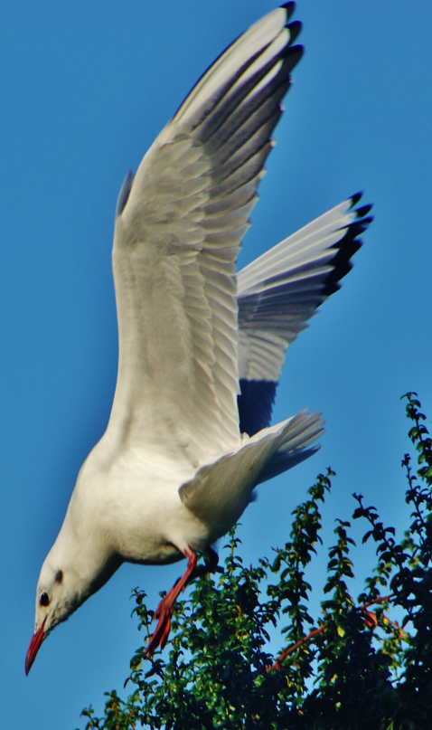
Are you guilty of adopting these styles?
Slash and burn
Tree hugger
Seagull

Slide 20
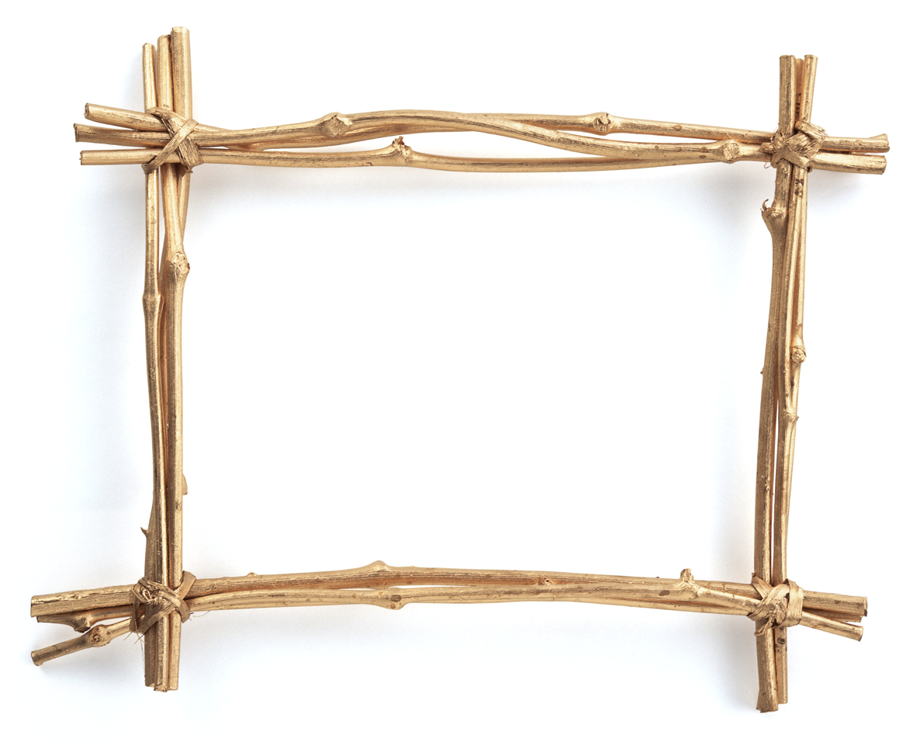
Picture this . . .
Tree
tree

Slide 21
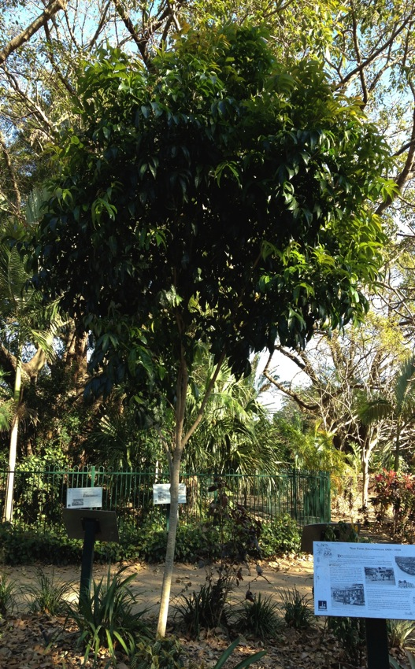
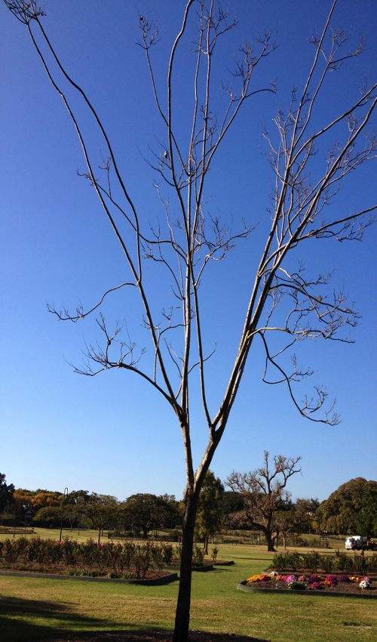
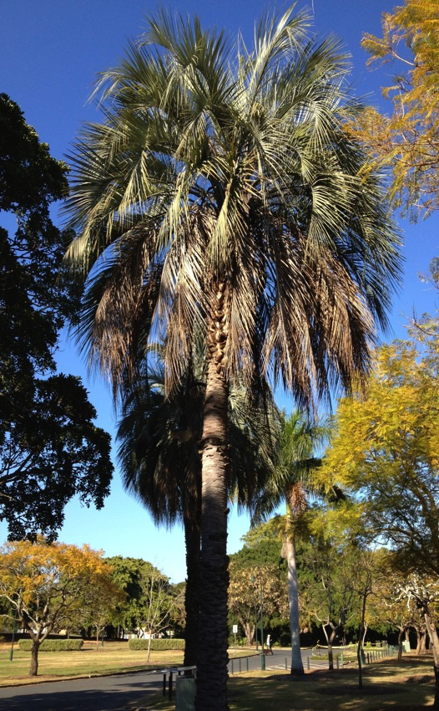
What does your tree look like?

Slide 22
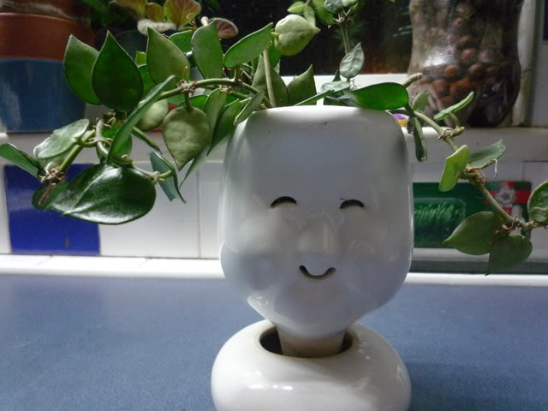
Do you have a growth mindset?
Notes:
Book by Carol Dweck
Fixed mindset - Intelligence and talent fixed at birth
Growth mindset – intelligence and talent can go up and down

Slide 23
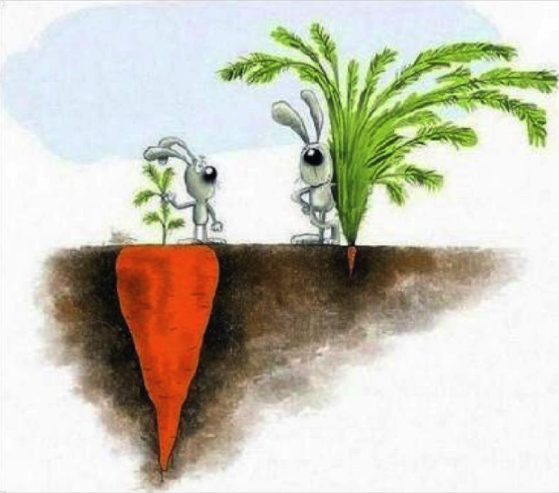
Growth can’t always be seen

Slide 24

5 questions you should be asking
How am I growing?
How am I helping my team to grow?
How am I helping my organisation to grow?
How am I helping my industry to grow?
How am I helping my occupation to grow?

Slide 25

3 ways to fast track your career
Volunteering
Mentoring
Reflecting

Slide 26
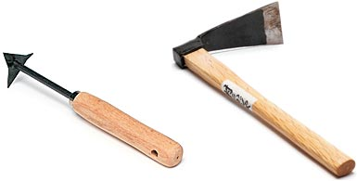
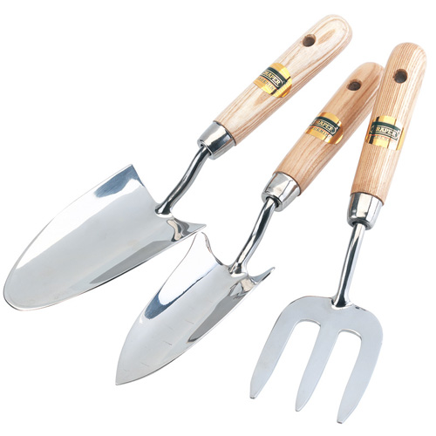
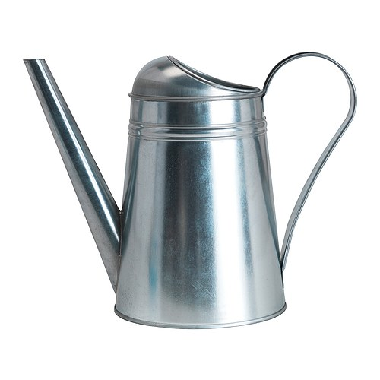
What action are you going to take?
Weed
Stop
Fertilise
Plant
Continue
Start

Slide 27
For more ideas sign up to receive free ebooks or newsletters www.letsgrow.com.au

